Slide 1
Hi Grade 3-4
I miss you like crazy! ☺
I have prepared 3 different types of work outs for you …actually more like 4, but who is counting?
I challenge you to do 3 workouts a week minimum. If you do 4-5 you better email me and tell me! I want to celebrate it and maybe we can start connecting more on flip grid. I will talk to your teachers and see if we can set up a PE section and you can share a cool pic or video of you moving. I hope you are well but remember that includes getting a bit physical! I will be in touch but for now start these activities even with your siblings or friends via facetime. It will be good to connect and do it with someone in another house. I know you have cards, dice, and most of you’re the internet.
Enjoy Defenders! - Mrs. Patterson

Slide 2
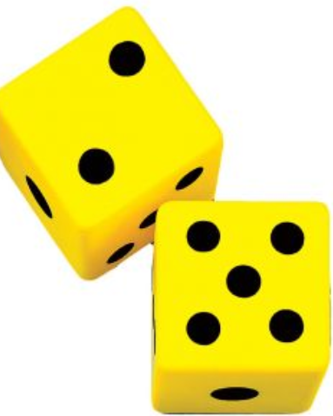
Fitness Dice Game
Set your timer
for 20 mins
Roll | Reps | Exercise
1 | 10 | Jumping Jacks
2 | 10 | Push ups
3 | 10 | Burpees
4 | 15 | Squats
5 | 12 | Lunges
6 | 10 | Sit ups
If you roll the same number twice & you want to do this instead | 1 min | Plank (on your forearms)

Slide 3
Fun fitness links to choose from!
Pick one of the two. Be sure to supplement these fitness workouts with a 20 min. walk or bike ride after.
Bring Sally UP & Down – 3:30 mins. Squat Challenge
Do squats to the song as it commands great leg work out.
https://www.youtube.com/watch?v=bql6sIU2A7k
Kids Zumba Home Workout
Complete three 2-min. workouts for each link. I tried to pick a couple favorite tunes
https://www.youtube.com/watch?v=ymigWt5TOV8
https://www.youtube.com/watch?v=FP0wgVhUC9w
https://www.youtube.com/watch?v=RoYxG0avSfY

Slide 4
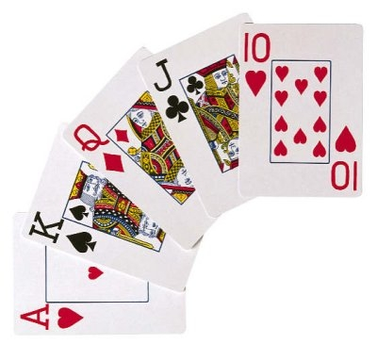
Fit War
Here’s how it works. Each suit on the cards are an exercise. The number on the card is the amount of repetitions of the exercise.
This is best to play with a partner but can be played alone if you set a timer for 20-25 mins. Or complete half the deck.
If playing with two people: Decide who is the dealer, deal half the deck to your partner. If you are on your own just take half the deck for yourself. If you both lay the same # you both have to do the exercise, otherwise the loser does the exercise.
Jacks -11
Kings- 12
Aces -1
Jokers – 15 Push Ups
Hearts- Squat Jumps
Spades- burpees
Clubs-Inch worm on the spot or on the move
Diamonds –mountain climbers

