Slide 1
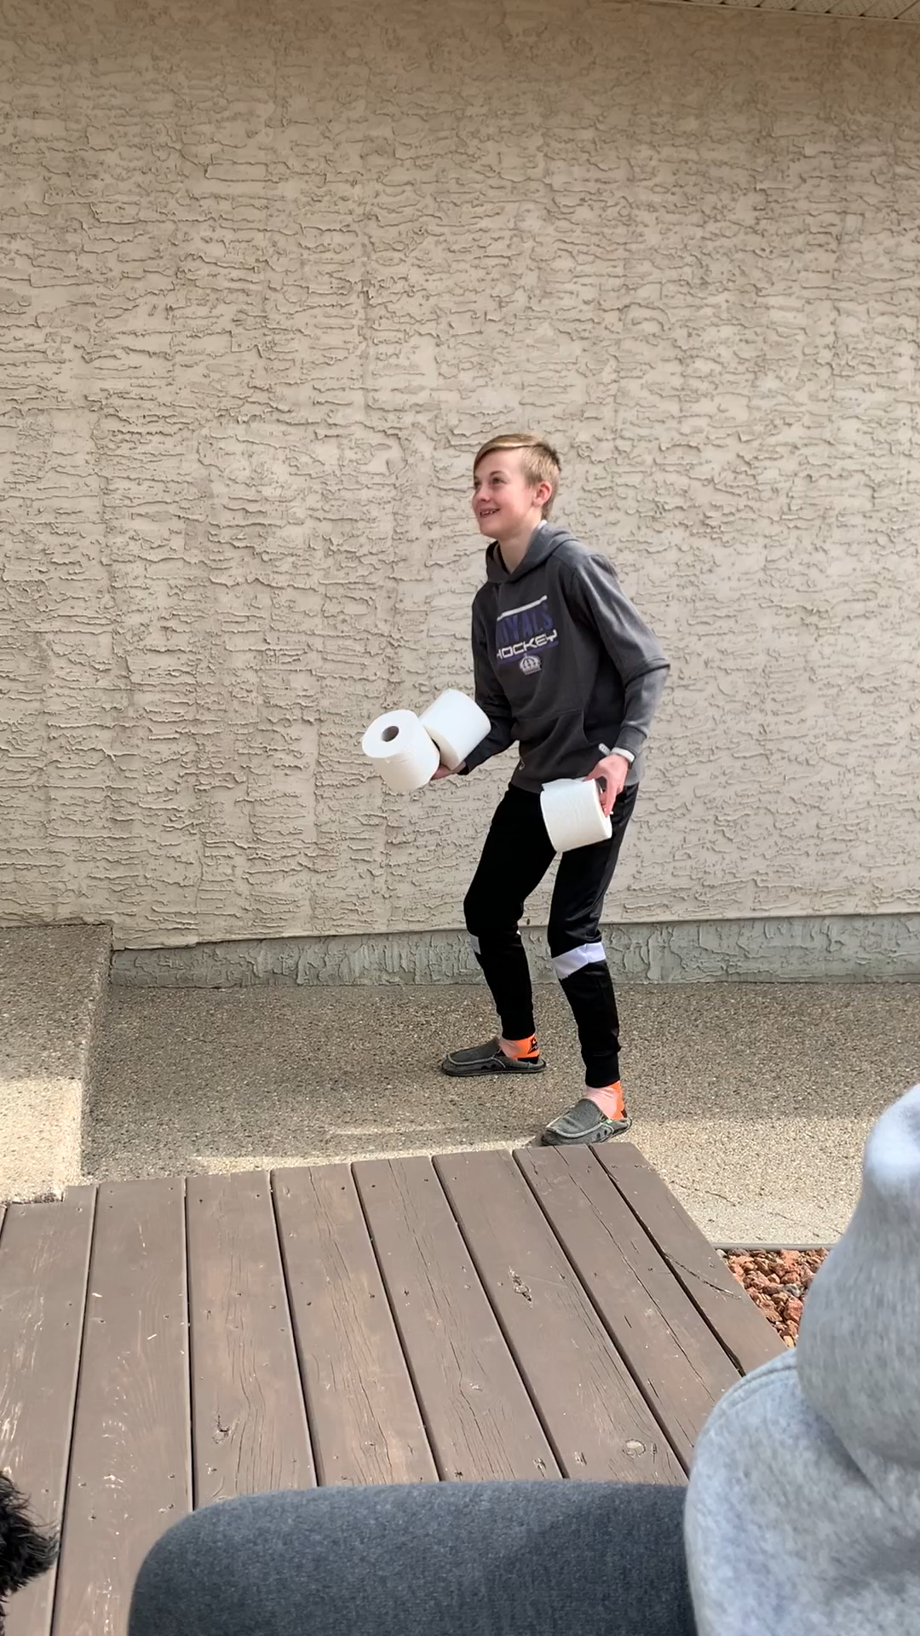
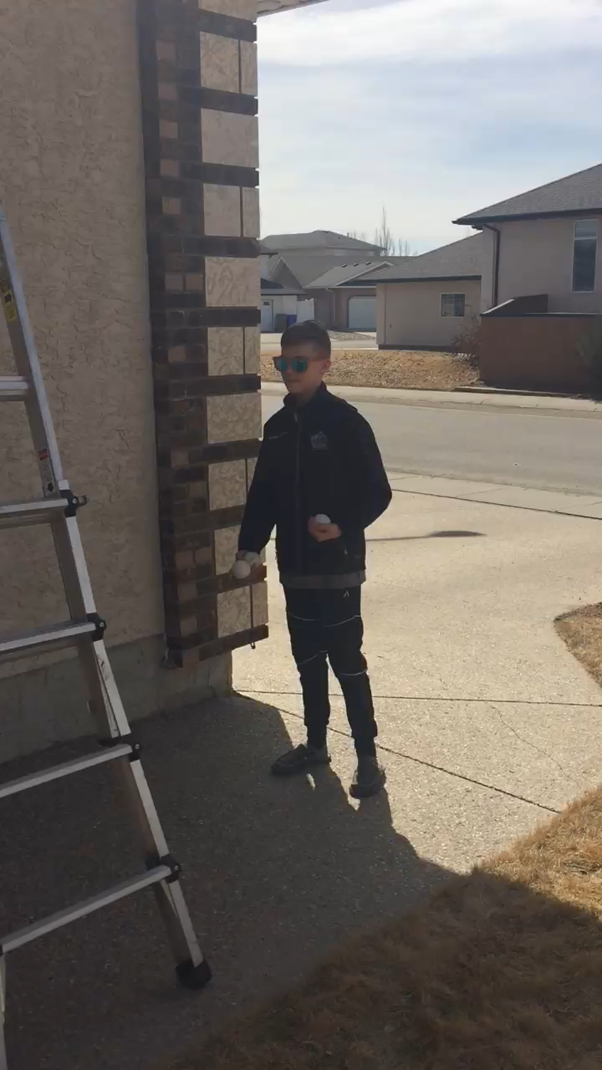
Welcome to some fun home skill development!
Here are three at home activities that you can work on and
develop skill! You can tweet out your video results
@coachpatty1 #activehomechallenges
or you can email me h.patterson@rcsd.ca
with a video doing your best.
Learn to juggle
My good friend Cooper is Gr 6 @St. Nicholas. He decided to
learn to juggle in isolation. (juggle with hands)
Use this website to learn and view Cooper’s success below
https://www.youtube.com/watch?v=dCYDZDlcO6g (Gr 4-8)
https://www.youtube.com/watch?v=QxzSHRbLAx4 (Gr ¾)

Slide 2
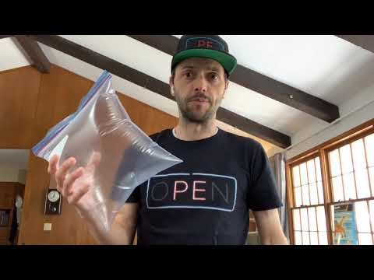
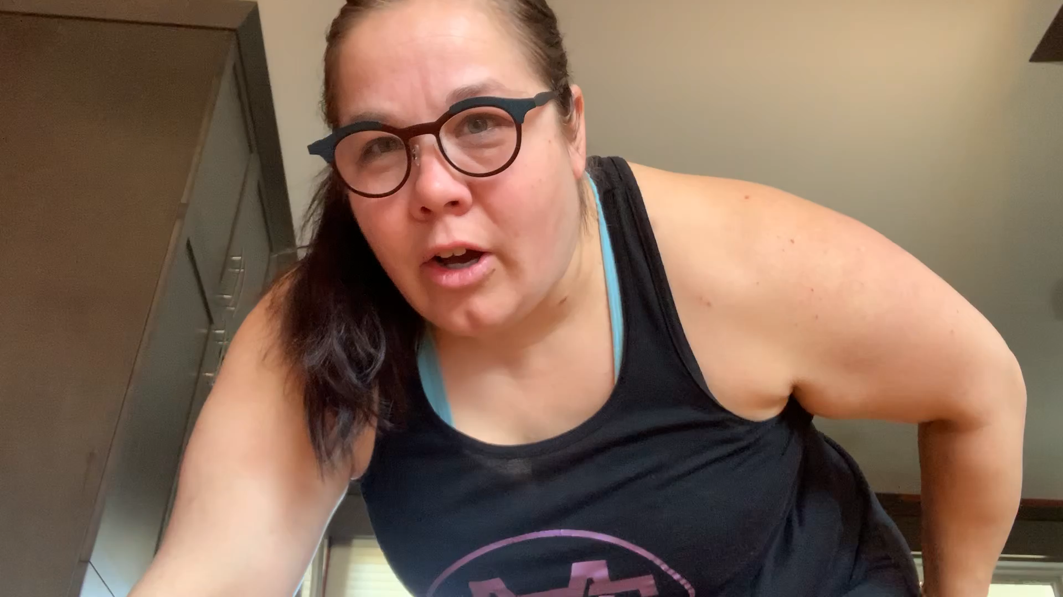
Juggle with your feet: Using ziplock bag to soccer juggle. My soccer players out there might be able to show me with a ball, but check this out! https://www.youtube.com/watch?v=c8UbCGI-uTI
10 pushup Challenge
Mr. Kauf challenged me to do 10 consecutive push ups on my
toes and tweet it out there #pushupchallenge or email me.
Turn sideways in your video so I can see your profile☺

Slide 3
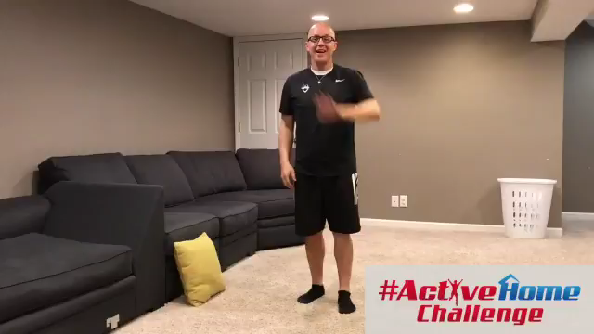
Striking and hitting a target: You need a target(laundry basket) A shoe, and a rolled up pair of socks. How many times can you hit the target in 45 secs? Time it and video it! Email it to me. https://twitter.com/MrSpringPE/status/1250425474825605120

