Slide 1

for motivating , encouraging and monitoring reading

Slide 2

What is Biblionasium?
Biblionasium, is a fun, free, website used to excite and encourage kids to read. With educator permission children are given an account to track their reading, connect to friends, to share book reviews, and offer recommendations.

Slide 3
Why use biblionasium?
It offers opportunities for kids to discover new books and get rewards for reading challenges.
Teachers, and parents, may monitor the student’s reading, book reviews, recommendations, and create challenges for their students.

Slide 4
What biblionasium can do for educators
fun and engaging reading community
will help you connect to your students outside of the classroom
setup your favorite books and recommended lists on virtual bookshelves that will be available to your students at all times
Students can email you their reading logs instead of handing them in on paper.
you can set up fun challenges and rewards that will help encourage your students to keep reading
set up a reading list that the students won’t lose
brings children together and gives them a chance to easily recommend books to each other

Slide 5
What kind of information do teachers see?
You can see the virtual bookshelves of your students which, among other things, hold a record of their favorite books.
You are able to see their reading history and can track their progress. Information is provided on the Reading Level of the books they are reading to help you assess if they are regularly reading at, below, or above their comprehension level.
In summary, information is provided,and tools to effectively and efficiently manage your students' reading curriculum.

Slide 6
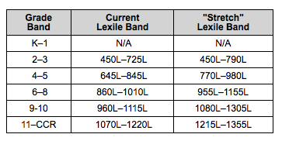
Tracking reading
When you search for a book from the Search field, the results will include the book's unique Lexile® measure.

Slide 7
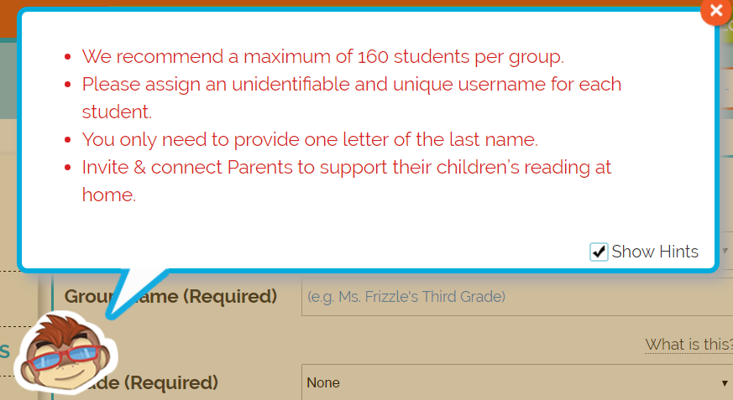
How safe is Biblionasium?
Biblionasium has taken aggressive measures to keep information safe. Data is stored on secure servers and industry standards are used to protect against hacking.
Only approved friends and the child’s registered educator can see the child’s name and school. Other signed-in users can see the child’s anonymous username, books, and other non-personal information. People who are not signed in to Biblionasium are unable to see any information on the site.
Using an anonymous username is one of the ways the child’s identity is kept safe on Biblionasium. The only people who know the kid behind the username are those who know the child personally; friends connect with one another via personal invitation.

Slide 8
How to start
With a parent and/or educator permission, children may be given an account
Registered Educators may act in the place of parents to sign up a child
Add a class
Add students and assign a reading/Lexile Level and username
Invite parents to connect (optional)

